Slide 1
Phrases utiles
❶ 我不 知道
wǒ bù zhīdào *知道 zhīdào = savoir
Je ne sais pas
❷ 我不 认识
wǒ bù rènshí
Je ne connais pas
*认识 rènshí= Rencontrer/ connaître

Slide 2
Oral practice:
Introduce your friend or classmates
-name
-nationality
-occupation

Slide 3
Review: 汉字(Hànzì) Chinese characters
口
Kǒu (mouth)
见
Jiàn (see, view)
山
Shān (mountain)
小
Xiǎo (small, little)
不
Bù (no, not)
不小
Bù xiǎo (not small)
中
Zhōng (middle, medium, central)
大
Dà (big, major)
人
Rén (person, people)
火
Huǒ (fire, flam)
女
Nǚ (female)
女人
Nǚrén (woman)
火山
Huǒshān (volcano)

Slide 4
Review: 25-March-2024
What is your name?
-Nǐ jiào shénme míngzì?
I am not Chinese
-Wǒ búshì Zhōngguó rén
She is a student
-Ta shì xuéshēng
We are French
-Wǒmen shì Fǎguó rén
They are American
-Tāmen shì Měiguó rén
He is a teacher, he is not a student, he is Italian.
-Tā shì lǎoshī, tā búshì xuéshēng. Tā shì Yìdàlì rén.
六十七
Liù shí qī = 67
四十八
Sì shí bā = 48
三十五
Sān shí wǔ =35
十九
Shí jiǔ =19
十一
Shí yī =11
You (polite)
Nín

Slide 5
Review: vocabulary /vocabulaire
Professor(teacher) Wang
Wáng lǎoshī
Chinese Friends
Zhōngguó péngyǒu
American friends
Měiguó péngyǒu
Chinese Teacher
Hànyǔ lǎoshī
Which country?
Nǎ guó?
Who
Shéi
student/étudiant(e)
xuéshēng
classmate/camarade de classe
tóngxué
friend
péngyǒu
sorry/excusez-moi
Duì bùqǐ
that's ok/ç'est ne pas grave
Méi guānxì

Slide 6
大 人
dà rén (adult/grown-ups)
小 心
xiǎo xīn (careful/watch out)
水 中
shuǐ zhōng (in the water)
中 心
zhōng xīn (centre)
心 中
xīn zhōng = in the heart, or in one’s heart
在 我 的 心 中 (zài wǒ de xīn zhōng),
It means 'in my heart’
-It's used to describe something deeply felt or something that you hold in your innermost thoughts and emotions.
-Il est utilisé pour décrire quelque chose de profondément ressenti ou quelque chose que vous gardez dans vos pensées et émotions les plus intimes.

Slide 7
我叫Wǒ jiào(I am called/je m'appelle) vs 我是Wǒ shì ( I am/ je suis)
Wǒ jiào(I am called/je m'appelle)
Wǒ shì ( I am/ je suis
Wǒ jiào ……..
Use wǒ jiào…., only when saying our own names.
- Nǐ jiào ……
Tā jiào …..
Wǒ shì ……..
While use wǒ shì ….,
To say our names, job titles, who we are, nationalities

Slide 8
Caractères chinois à apprendre
❶ 日 ri =day, sun
❷ 明 míng =bright, light
❸ 东 dōng= East /Est
❹ 我 wǒ = I, me / je, moi
❺ 西 xī =west / Ouest
❻ 国 guó = country/ pays
❼ 东西dōng xī = things or objects /chose, objet

Slide 9

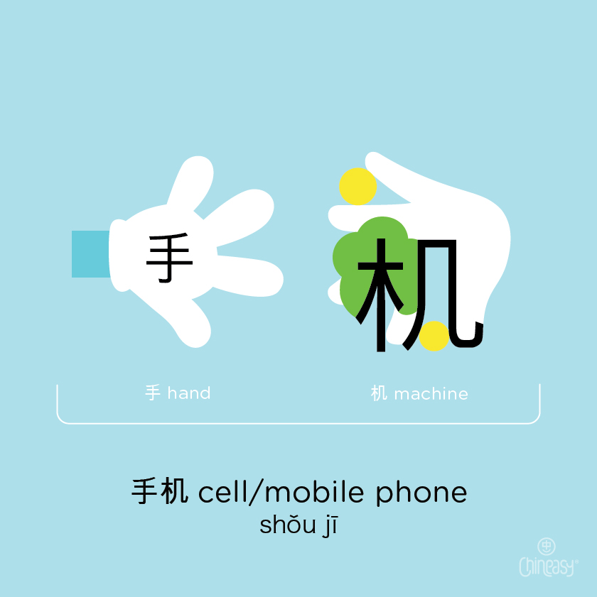

手机shǒujī = cell phone /téléphone portable

Slide 10
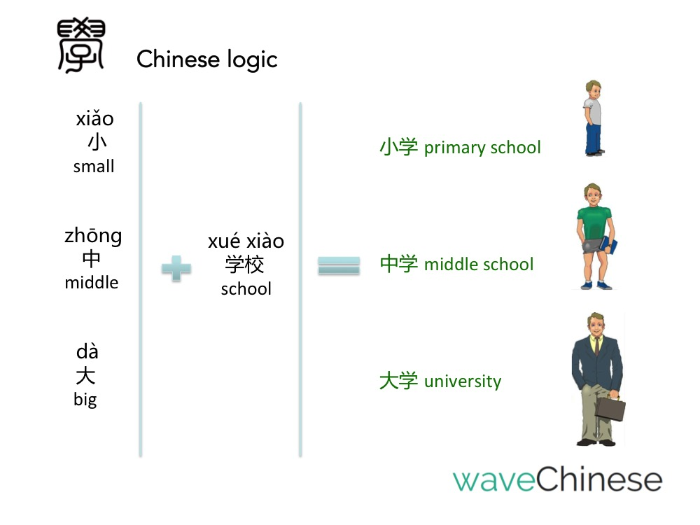

Slide 11
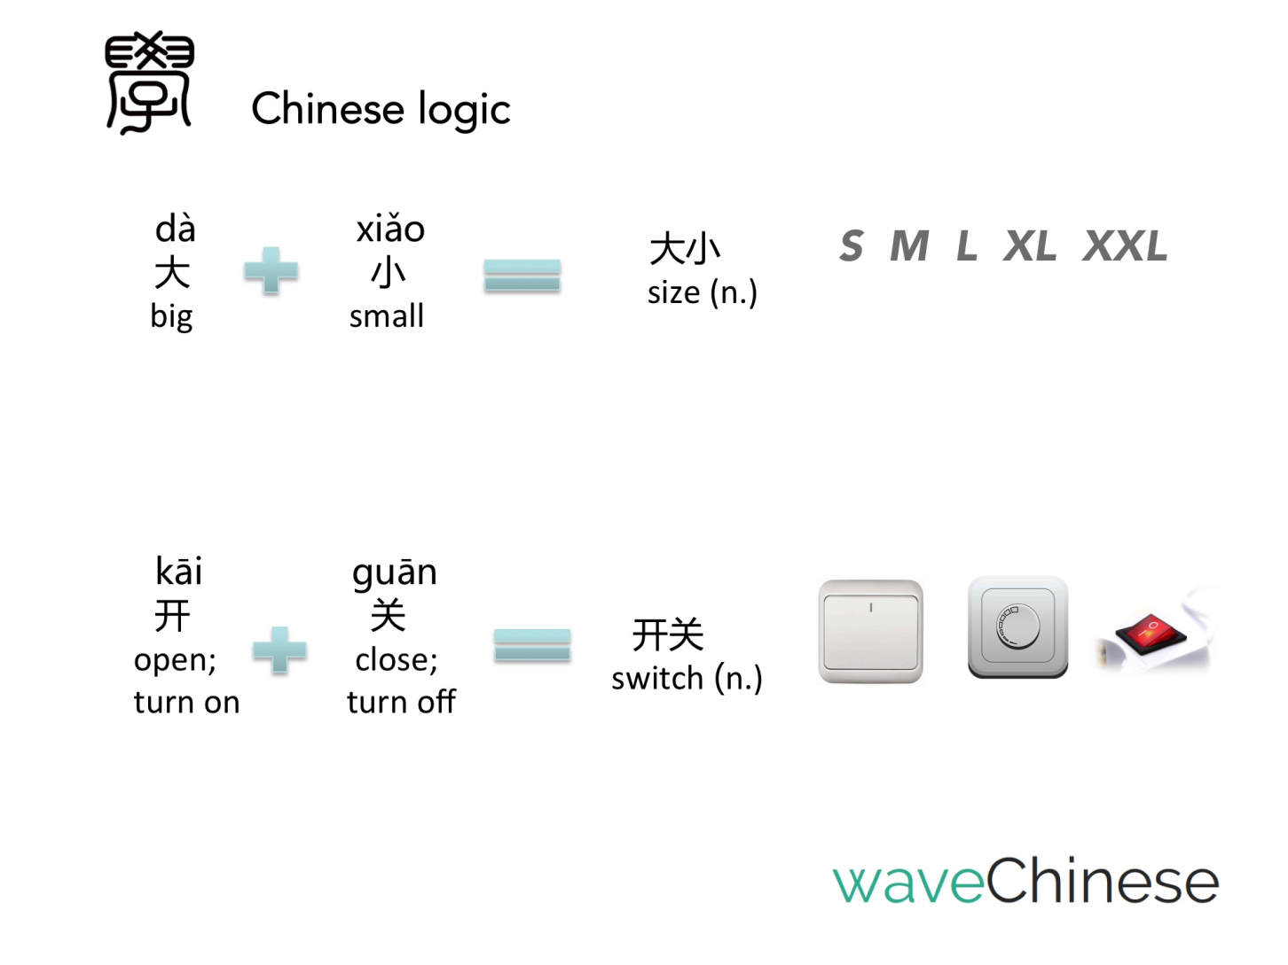

Slide 12
Useful question words
❶ 谁 sheí (lesson 4)
❷ 什么 shénme (lesson3)
❸ 哪 nǎ=(quel, quelle, laquel..) (lesson 4)
❹ 哪儿nǎr (lesson9)
❺ 几 Jǐ (lesson5)
(quelques,plusieurs) (lesson5)
- 几岁jǐ suì (quel âge? (-10)
- 几口人jǐ kǒu rén?
❻ 为什么 wèishénme (hsk 2)
❼ 多 duō (numbreux) (lesson 5, 8)
a.多大了?duōdà le (quel âge?)
b.多少?duōshǎo (combien?)
c.多少钱? duōshǎo qián (combien ça coûte?)
❶ who (lesson 4)
❷what (lesson 3)
❸ which (lesson4)
❹ where (lesson 9)
❺ how many(usually less than 10)
- how old are you? (ask children age -10)
- How many people in your family?
❻ why (hsk 2)
❼ much, more / how (lesson 5, 8)
a. how old are you (+10 yrs old)
b. how much, how many
c. how much money?

